Slide 1

Global Airport Analysis
A deep dive into the correlation between airport distribution, economic strength, and geographical nuances.
Data Analysis Final Project
Submitted to : Lighthouse Lab
Submitted by: Ahnaf Shabik
Date: 17th August 2023

Slide 2

Table of Contains:
Data Collection , Preprocessing, EDA
Airport Distribution Analysis
Economic Analysis
Airport Altitude Analysis
Airport Infrastructure vs. Economic and Population Size
Conclusion & Recommendations
Thank You/Questions

Slide 3
Introductions
Objective of the Study
Economic Implications:
Geographical Significance
Strategic Importance:

Slide 4
Data Journey: Collection to Exploration
Data Source
Data Cleaning
Data Processing
Exploratory Data Analysis (EDA):

Slide 5
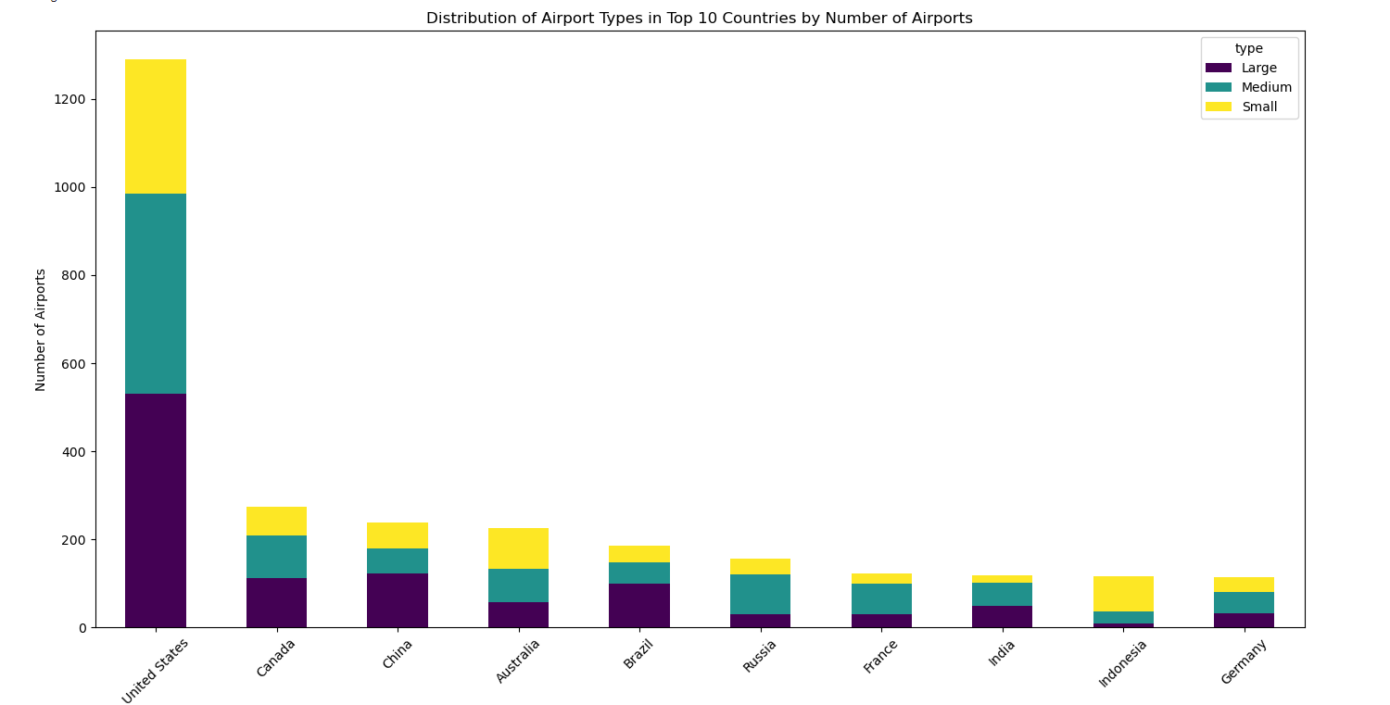
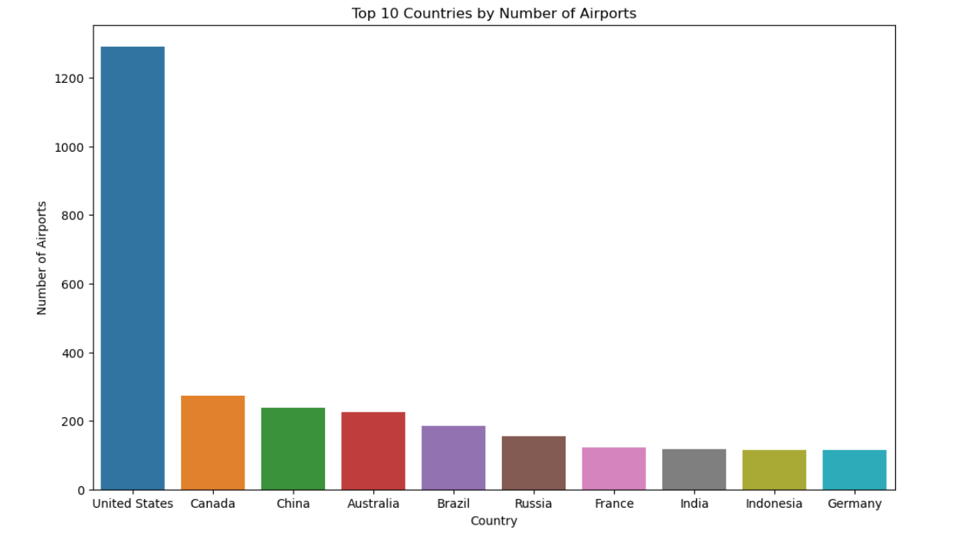
Airport Distribution Analysis
Most Number of Airports: USA
Airport Types & Economy
Canada & Russia Balance
Economic Significance
Tourism & Growth

Slide 6
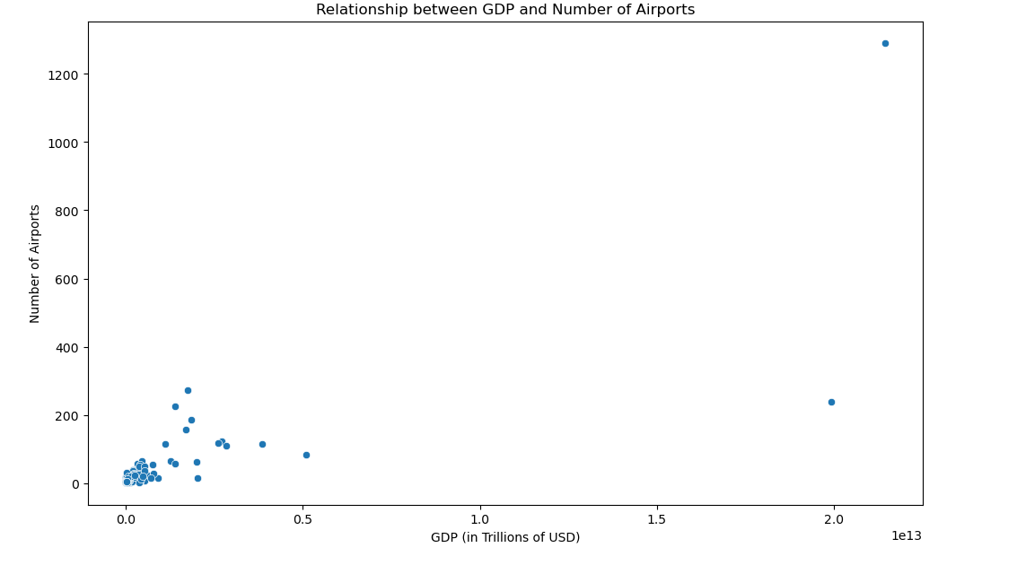
Economic Analysis (GDP vs Number of Airports)
Positive Correlation
Economic Indicator
Business & Trade Hub
Growing Demand
Economic Accessibility

Slide 7
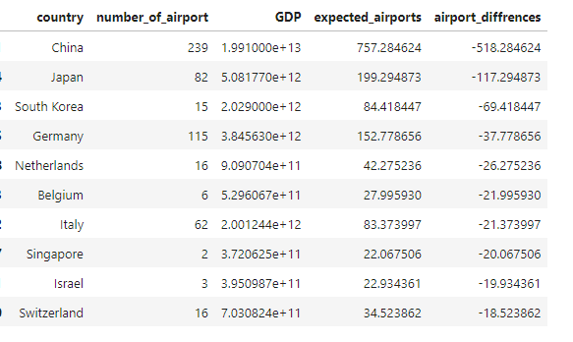
Economic Analysis (Countries with High GDP, Few Airports)
China: Discrepancy of 518 airports.
GDP is a significant, but not exclusive.
Geography, history, policies, and economic nature

Slide 8
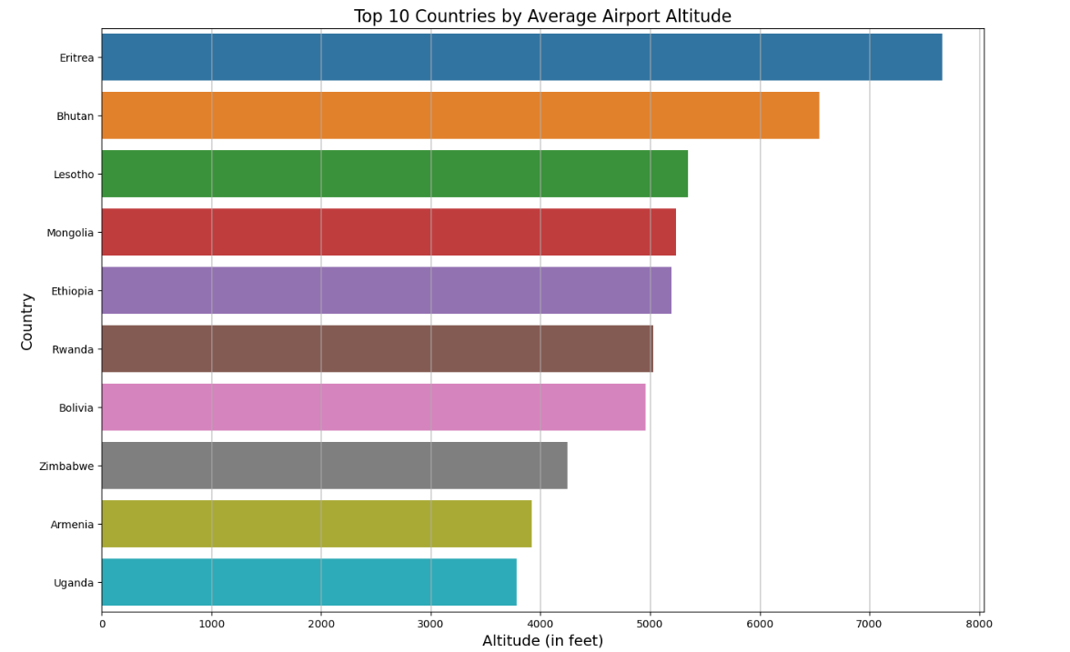
Airport Altitude Analysis
Findings
Geographic Influences
Implications
Recommendations

Slide 9
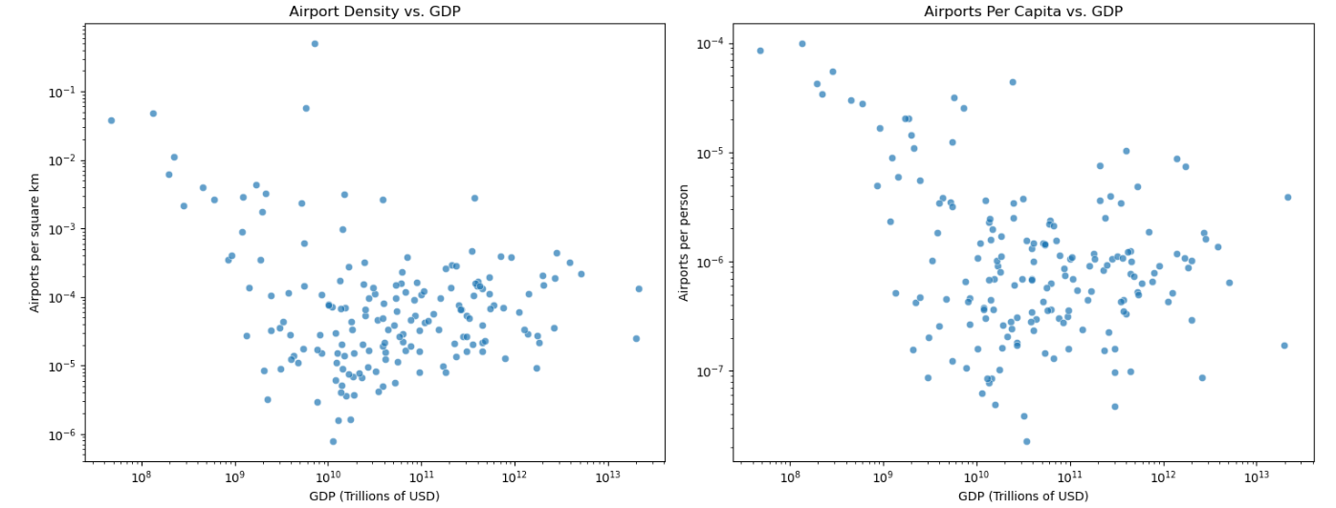
Airport Infrastructure vs Economic & Population Size

Slide 10
Airport Infrastructure vs Economic & Population Size
Airport Density vs GDP
Airports Per Capita vs GDP
Key Findings

Slide 11
Conclusion
Complex Relationship
GDP's Role
Additional Factors
Strategic Planning
Informed Decisions

Slide 12
Recommendations
Infrastructure Investment
Balanced Prioritization
Collaborative Strategies
Data-Driven Decisions

Slide 13
Thank you
Question/Answer

